Slide 1
HTML 5 & JavaScript
N Satya Narayana
CDAC

Slide 2
HTML Examples
Hypertext Markup Language
Web page structure is defined using markup language usually in terms of HTML tags
Browsers use HTML tags to render the content of the page
Example tags:
body <body></body>
paragraph <p></p>
<html>
<head>
</head>
<body> </body>
</html>

Slide 3
HTML Element
<element name attributes event handlers>
Element name: a, p, h1..h6, body, div, table, tr, td, span, section, article, header, footer,
Attributes: class, style, id, src, width, height, href, spellcheck, data-*, tabindex
All attributes are not applicable to all elements.
All attributes may not be supported by all the browsers (e.g., contextmenu)

Slide 4
HTTP vs HTML
HTML: hypertext markup language
Definitions of tags that are added to Web documents to control their appearance
HTTP: hypertext transfer protocol
The rules governing the conversation between a Web client and a Web server
Both were invented at the same time by the same person

Slide 5
What is a protocol?
In diplomatic circles, a protocol is the set of rules governing a conversation between people
We have seen that the client and server carry on a machine-to-machine conversation
A network protocol is the set of rules governing a conversation between a client and a server
There are many protocols, HTTP is just one
Notes:
Follow protocol – follow the rules of the conversation

Slide 6
An HTTP example
The message requesting a Web page must begin with the work “GET” and be followed by a space and the location of a file on the server, like this:
GET /fac/lpress/shortbio.htm
The protocol spells out the exact message format, so any Web client can retrieve pages from any Web server.

Slide 7
Network protocols
The details are only important to developers.
The rules are defined by the inventor of the protocol – may be a group or a single person.
The rules must be precise and complete so programmers can write programs that work with other programs.
The rules are often published as an RFC along with running client and server programs.
The HTTP protocol used for Web applications was invented by Tim Berners Lee.
RFC = request for comments

Slide 8
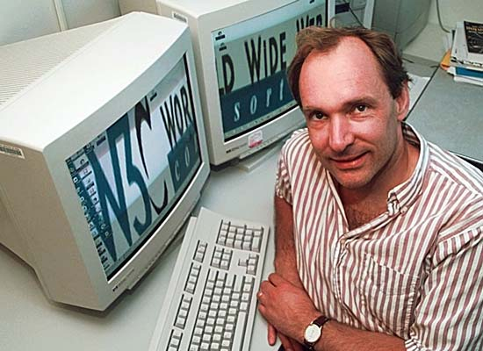
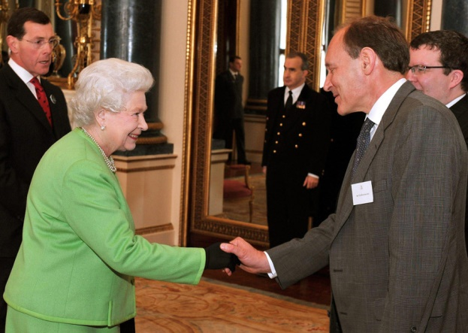
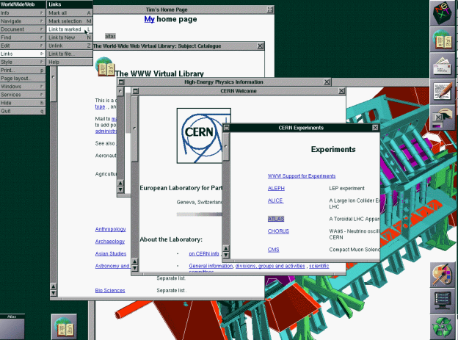
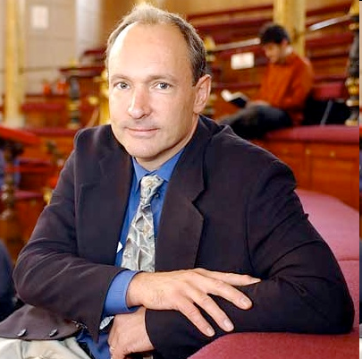
Tim Berners-Lee
Tim Berners-Lee was knighted by Queen Elizabeth for his invention of the World Wide Web. He is shown here, along with the first picture posted on the Web and a screen shot from an early version of his Web browser.
Notes:
http://is.blick.ch/img/gen/F/4/HBF4oEql_Pxgen_r_900x641.jpg

Slide 9
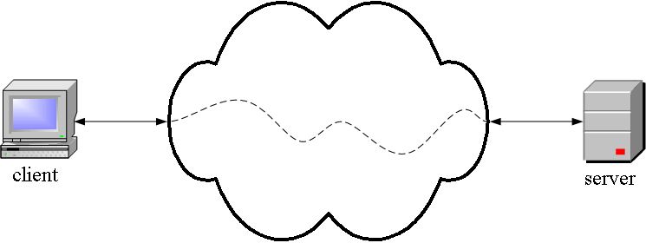
HTTP is an application layer protocol
The Web client and the Web server are application programs
Application layer programs do useful work like retrieving Web pages, sending and receiving email or transferring files
Lower layers take care of the communication details
The client and server send messages and data without knowing anything about the communication network

Slide 10
Many application layer protocols are used on the Internet, HTTP is only one
Protocol | Application
HTTP: Hypertext Transfer | Retrieve and view Web pages
FTP: File Transfer | Copy files from client to server or from server to client
SMTP: Simple Mail Transport | Send email
POP: Post Office | Read email

Slide 11
The TCP/IP protocol layers
The application program is king – it gets work done using the lower level layers for communication between the client and server.
Application
Transport
Internet
Data link
Physical
Get useful work done – retrieve Web pages, copy files, send and receive email, etc.
Make client-server connections and optionally control transmission speed, check for errors, etc.
Route packets between networks
Route data packets within the local area network
Specify what medium connects two nodes, how binary ones and zeros are differentiated, etc,

Slide 12
Uniform Resources
URL
Uniform Resource Locator
Refers to an existing protocol
http:, wais:, ftp:, mailto:, gopher:, news:
Points to a document on a specific server
URN
Uniform Resource Name
Globally unique, persistent identifier
Independent of location

Slide 13
Uniform Resources
URI
Uniform Resource Identifier
Uniform Resource Identifier (URI) is a string of characters used to identify a resource.
Collection of URL’s and URN’s
A URL is a URI that, in addition to identifying a web resource, specifies the means of acting upon or obtaining the representation of it, i.e. specifying both its primary access mechanism and network location.
A URN is a URI that identifies a resource by name in a particular namespace. A URN may be used to talk about a resource without implying its location or how to access it.

Slide 14
URL
<scheme> : //<host> :<port> /<path> ;<parameters> ?<query> #<fragment>
scheme
The protocol you are using
host
Host name or ip number
port
TCP port number that protocol server is using
path
Path and filename reference of object on server

Slide 15
URL and HTTP
All parts of URL, except parameters, used with http
Scheme and host can be omitted when referenced object is on same machine as referring document
Port can be omitted so long as referenced host is running on port listed in your /etc/services file
Usually port 80

Slide 16
Web Documents
html
ASCII text
Preformatted
postscript
Images
GIF
JPEG
Video
MPEG
jsp, asp

Slide 17
Communication
Server tells client what type of information is coming before information arrives
File extensions
.html .htm
.txt
.ps
.au
.gif .tiff .jpeg
.mpeg
.java

Slide 18
Communication
Text and inline images
Separate objects
Client browser may optionally send a list of formats it can accept
Document can be a program
Web server executes program and sends results to client
Generic term for this program is script, gateway, or gateway script

Slide 19
Gateways
Translates from one protocol or service to another
HTTP / database query
Database query results / HTTP

Slide 20
HTTP 1.0
Berners Lee, Fielding, Nielsen - 1995
Used in hypermedia systems distributed across networks
Defines request-response conversation
Requesting program (client) establishes connection with receiving program (server)
Client sends request to server
HTTP specifies syntax

Slide 21
HTTP 1.0
Defines request-response conversation
Server replies with response
http specifies syntax
Does not handle network connectivity or how information is transmitted
TCP/IP does this

Slide 22
HTTP 1.0
HTTP request
Method
URI
Protocol version
Optional other information
HTTP Message format
Method [Request URI] HTTP/1.0 <CRLF>

Slide 23
HTTP 1.0
Method
Get
Returns object
Head
Returns information about object
Post
Sends information to be stored on server or as input to script

Slide 24
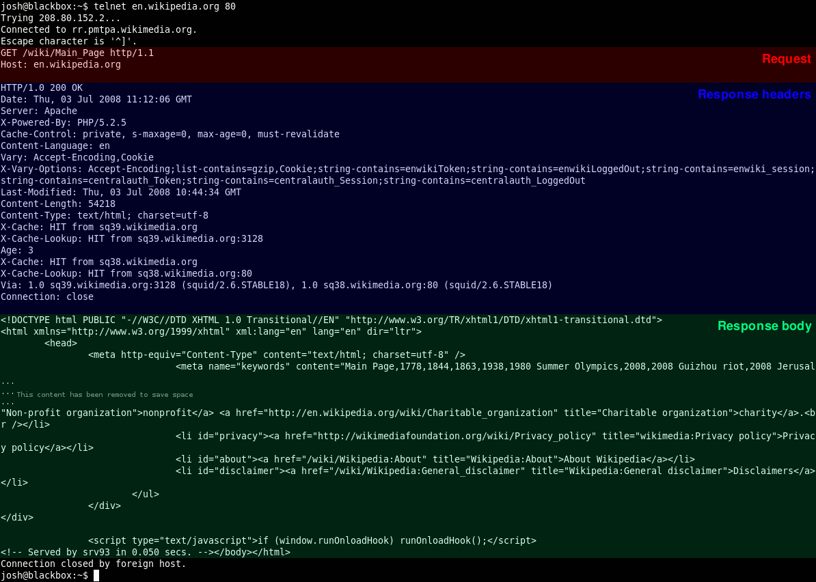
Snapshot of GET method

Slide 25
HTTP 1.0
Other information
User Agent
Kind of browser
If-Modified-Since
Returns object only if more recent than given date
Otherwise returns status code 304

Slide 26
HTTP 1.0
Other information
Accept
Mime types which browser can accept
Multipurpose Internet Mail Extension
text/plain
text/html
application/postscript
image/gif
image/jpeg
audio/basic
video/mpeg
x-world/x-vrml

Slide 27
HTTP 1.0
Other information
Authorization
User password
GET /X/Y/Z.HTML HTTP 1.0
User Agent: Prodigy-WB/1.3e
Accept: text/plain
Accept: text/html
Accept: application/postscript
Accept: image/gif
Accept: */*

Slide 28
HTTP 1.0
HTTP response
Status line
HTTP-version Status-code Reason
Status-codes 1xx - Informational
Reserved for future use

Slide 29
HTTP 1.0
HTTP response
Status line
Status-codes 2xx - Success
The action was successfully received, understood, and accepted
200 OK
201 POST command successful
202 Request accepted
203 GET or HEAD request fulfilled
204 No content

Slide 30
HTTP 1.0
HTTP response
Status line
Status-codes 3xx - Redirection
Further action must be taken in order to complete request
300 Resource found at multiple locations
301 Resource moved permanently
302 Resource moved temporarily
304 Resource has not modified (since date)

Slide 31
HTTP 1.0
HTTP response
Status line
Status-codes 4xx - Client error
The request contains bad syntax or cannot be fulfilled
400 Bad request from client
401 Unauthorized request
402 Payment required for request
403 Resource access forbidden
404 Resource not found
405 Method not allowed for resource
406 Resource type not acceptable

Slide 32
HTTP 1.0
HTTP response
Status line
Status-codes 5xx - Server error
The server failed to fulfill an apparently valid request
500 Internal server error
501 Method not implemented
502 Bad gateway or server overload
503 Service unavailable / gateway timeout
504 Secondary gateway / server timeout

Slide 33
HTTP 1.0
HTTP response
Description of information
Server Type of server
Date Date and time
Content-Length Number of bytes
Content-Type Mime type
Content-Language English, for example
Content-Encoding Data compression
Last-Modified Date when last modified
Expires Date when file becomes
invalid

Slide 34
HTTP 1.0
Problems
HTTP is stateless
Each request requires separate TCP connection
Server doesn’t remember previous requests

Slide 35
Http 1.1
OPTIONS method
A way for a client to learn about the capabilities of a server without actually requesting a resource
Put
Sends new copy of existing object to server
Usually not allowed
Delete
Deletes object
Usually not allowed
Trace
Acts as traceroute command to trace the resource on the server
Persistent and Pipelining

Slide 36
HTML5: What is it?
HTML5 will be the new standard for HTML, XHTML, and the HTML DOM (document object model).
The previous version of HTML came in 1999. The web has changed a lot since then.
HTML5 is still a work in progress, but most modern browsers have some HTML5 support.

Slide 37
History of HTML
1991
HTML first published
1995
HTML 2.0
After HTML 4.01 was released, focus shifted to XHTML and its stricter standards.
1997
HTML 3.2
1999
HTML 4.01
XHTML 2.0 had even stricter standards than 1.0, rejecting web pages that did not comply. It fell out of favor gradually and was abandoned completely in 2009.
2000
XHTML 1.0
2002 -2009
HTML5 is much more tolerant and can handle markup from all the prior versions.
XHTML 2.0
HTML5
Though HTML5 was published officially in 2014, it has been in development since 2004.
2014

Slide 38
Major Improvements
GUI with non-Flash application
New Elements (Focused more on semantics and accessibility)
Video, Canvas, Input (built-in support for form validations)
JavaScript API
File Reader, Web Audio, User Media (p2p connection), Session/Local Storage (in place of cookies)

Slide 39
HTML5: Origins
HTML5 is a cooperation between the World Wide Web Consortium (W3C) and the Web Hypertext Application Technology Working Group (WHATWG).
WHATWG was working with web forms and applications, and W3C was working with XHTML 2.0. In 2006, they decided to cooperate and create a new version of HTML.

Slide 40
HTML5: Ground Rules
Some rules for HTML5 were established:
> New features should be based on HTML,
CSS, DOM, and JavaScript
> Reduce the need for external plugins
> Better error handling
> More markup to replace scripting
> HTML5 should be device independent
> Dev process should be visible to the public

Slide 41
HTML5: New Features
> Canvas element for drawing
> Video/audio elements for media playback
> Better support for local offline storage
> New content specific elements, like article, footer, header, nav, section
> New form controls, like calendar, date, time, email, url, search

Slide 42
It is all about…..
Providing powerful capabilities for Web-based applications with more powerful interaction, video support, graphics, more styling effects, and a full set of APIs.
Evolve as a future Open Web Platform

Slide 43
HTML5: Support
You may well ask: “How can I start using HTML5 if older browsers don’t support it?” But the question itself is misleading.
HTML5 is not one big thing; it is a collection of individual features. You can only detect support for individual features, like canvas, video, or geolocation.

Slide 44
HTML5: Example
HTML5 supports all the form controls from HTML 4, but it also includes new input controls. Some of these are long-overdue additions like sliders and date pickers; others are more subtle...

Slide 45
HTML5: Example
For example, the email input type looks just like a text box, but mobile browsers will customize their onscreen keyboard to make it easier to type email addresses. Older browsers that don’t support the email input type will treat it as a regular text field, and the form still works with no markup changes or scripting hacks.

Slide 46
HTML5: DOCTYPE
The DOCTYPE which comes before the beginning <html> tag is much simpler in HTML 5. Here are some examples of what it looks like now...
<!DOCTYPE HTML>
<!DOCTYPE HTML PUBLIC "-//W3C//DTD HTML 4.01//EN" "http://www.w3.org/TR/html4/strict.dtd">
<!DOCTYPE HTML PUBLIC "-//W3C//DTD HTML 4.01 Transitional//EN" "http://www.w3.org/TR/html4/loose.dtd">
<!DOCTYPE html PUBLIC "-//W3C//DTD XHTML 1.1//EN" "http://www.w3.org/TR/xhtml11/DTD/xhtml11.dtd">

Slide 47
HTML5
More focused on semantics of the document structure so that it is more accessible
Encourages separation of presentation stuff (color, style etc.)
Lessens developer efforts on HTML coding (e.g., input validation stuff especially)

Slide 48
Background
HTML was primarily designed as a language for semantically describing scientific documents, although its general design and adaptations over the years have enabled it to be used to describe a number of other types of documents.
The main area that has not been adequately addressed by HTML is a vague subject referred to as Web Applications.
Source: W3C Technical Specification about HTML5

Slide 49
Contd…
HTML5 is targeted specifically at applications that would be expected to be used by users on an occasional basis, or regularly but from disparate locations, with low CPU requirements.
Examples of such applications include
online purchasing systems,
searching systems,
games (especially multiplayer online games),
public telephone books or address books,
communications software (e-mail clients, instant messaging clients, discussion software),
document editing software, etc.

Slide 50


HTML5 Elements
Anchor tag
Image vs Picture

Slide 51
Form Submission
(Input validation) ? Client Side : Server Side
If java script enabled – Client Side
If java script not enabled – Server Side
In HTML5, no java script required for client side input validation

Slide 52
Input Types
Form
Date (Works with chrome but not with Firefox)
Number
Fixed Increment
Placeholder
Output – Displays out put return by a script
Required
Constraint validation method
Datalist
Type can be one of datetime, time, week, month, range with min and max attributes etc.

Slide 53
Media Elements
HTML5 supports following video formats
Ogg
Mpeg-4 (Mp4)
WebM
HTML5 supports following audio formats
MP3, WAV and Ogg

Slide 54
Media Elements
Before HTML5 there was no standard for showing videos on a web page
HTML5 video tag specifies a standard way to embed a video in a web page
Example:
<video width="320" height="240" controls> <source src="movie.mp4" type="video/mp4"> <source src="movie.ogg" type="video/ogg"> Your browser does not support the video tag. </video>

Slide 55
HTML5 Canvas
Canvas element is used to draw graphics on the fly via scripting
It is only a container for graphics and use some scripting to actually draw on the canvas
Example: <canvas id="myCanvas" width="200“ height="100" style="border:1px solid #000000;">
The getContext() method returns an object of type canvas which has several methods to be invoked on it for drawing purpose.

Slide 56
Contd….
Canvas JavaScript drawing API supports different kind of shapes: lines, rectangles, ellipses, arcs, curves, text, images
The canvas is also used to do animations at 60 frames per second (useful for games), to display videos with special effects, to display a webcam stream, and so on

Slide 57
Contd…
The canvas is also used to do animations at 60 frames per second (useful for games), to display videos with special effects, to display a webcam stream, and so on.

Slide 58
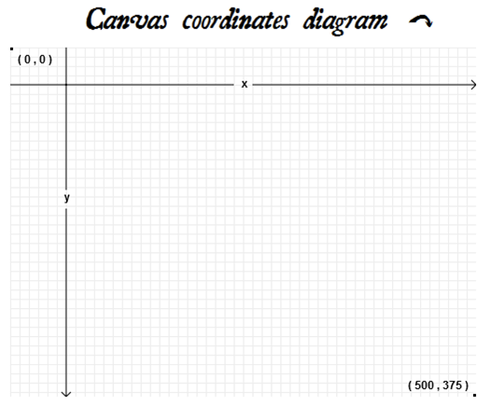
Coordinate System of Canvas
The coordinate system used for drawing in canvases is similar to the one used by many drawing APIs like Java2D: the (0 , 0) is in the top left corner while the X axis is going to the right and the Y axis to the bottom, as shown in the following picture

Slide 59
Canvas Context Properties
fillStyle fill mode
strokeStyle wireframe mode
font
lineWidth

Slide 60
Canvas Methods
context.fillStyle = “red”
context.fillRect(0,0,80,80) – tL,tR,w,h
context.clearRect(0,0,80,80)
Actually it draws it in a color called "transparent black" (!) that corresponds to the initial state of the rectangle as if no drawing had occurred
context.strokeStyle = “red”
context.lineWidth = 3; //Applicable only when shape is drawn in wireframe mode
context.strokeRect(0,0,80,80) – tL,tR,w,h
Example

Slide 61
Few more methods
context.fillText(msg,w,h)
context.strokeText(msg,w,h)
context.translate(offsetX,offsetY)
context.rotate(angle)
context.save()
context.restore()
Example

Slide 62
Canvas Drawing Mode
Immediate drawing mode
Previous example corresponds to
Path mode or buffered mode
Rectangles are the only shapes that have methods for drawing them immediately and also other methods for drawing them in "path/buffered mode".

Slide 63
HTML5 Drag and Drop
Steps:
Make an element draggable by setting draggable attribute to true. <img draggable=true>
Set an event listener for dragstart that stores the data being dragged.
Set an event listener for drop event
Example

Slide 64
Semantics
A semantic element describes the meaning of the element
Example: <div> and <span>
Example: <form>, <table>, <img>
These definitions allow HTML processors, such as Web browsers or search engines, to present and use documents and applications in a wide variety of contexts that the author might not have considered.

Slide 65
Few Use cases
HTML conveys meaning rather than presentation
Same page may be viewed on different devices
Quick navigation to parts of the document (speech browsers)
Improves indexing of pages by search engines
Table of contents can be generated
Authors must not use elements, attributes, or attribute values for purposes other than their appropriate intended semantic purpose, as doing so prevents software from correctly processing the page.

Slide 66
A simple example
(Usage of disk space) ? Progress : meter
Why?
The progress element represents the completion progress of a task.
The meter element represents a scalar measurement within a known range, or a fractional value

Slide 67
HTML Content
Each HTML element must abide by rules defining what kind of content it can have.
These rules are grouped into content models common to several elements.
HTML conformant document is the one which follows these rules.

Slide 68
Content Categories
Main content categories, which describe common content rules shared by many elements;
Form-related content categories, which describe content rules common to form-related elements;
Specific content categories, which describe rare categories shared only by a few elements, sometimes only in a specific context.

Slide 69
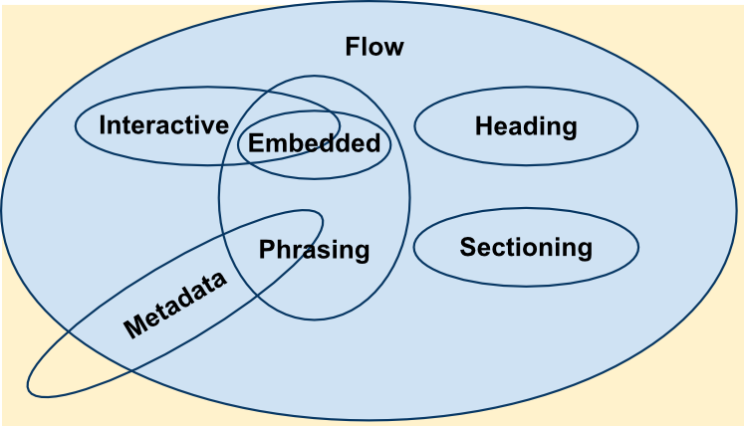
Content Categories
Source: https://developer.mozilla.org/en-US/docs/Web/Guide/HTML/Content_categories

Slide 70



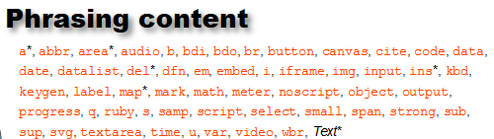


Content Category Description

Slide 71
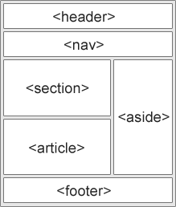
Web page structure

Slide 72
HTML5 - New Elements for better document structure
Tag | Description
<header> | Defines a header for the document or a section
<footer> | Defines a footer for the document or a section
<section> | Defines a section in the document
<article> | Defines an article in the document
<aside> | Defines content aside from the page content
<details> | Defines additional details that the user can view or hide
<dialog> | Defines a dialog box or window
<figcaption> | Defines a caption for a <figure> element
<figure> | Defines self-contained content, like illustrations, diagrams, photos, code listings, etc.

Slide 73
Contd…
Tag | Description
<nav> | Defines navigation links in the document
<progress> | Defines the progress of a task
<summary> | Defines a visible heading for a <details> element
<time> | Defines a date/time

Slide 74
Section Element
A section is a thematic grouping of content, typically with a heading.
<section> <h1>Interfaces</h1> <p>Java doesn’t support true multiple inheritance....</p> </section>

Slide 75
Article Element
This element specifies independent, self-contained content.
It should be possible to read it independently from the rest of the website.
Blog post, Technical article

Slide 76
Nesting of Elements
(Nesting of elements) ? Possible : Not Possible
<section> elements can have <article> elements
<article> elements can have <sections> elements

Slide 77
HTML5: MIME types
Every time your web browser requests a page, the web server sends “headers” before it sends the actual page markup. Headers are important, because they tell your browser how to interpret the page markup that follows.
MIME = Multipurpose Internet Mail Extensions

Slide 78
HTML5: MIME types
The most important header is called Content-Type, and it looks like this:
Content-Type: text/html
“text/html” is called the “content type” or “MIME type” of the page.

Slide 79
HTML5: MIME types
This header is the only thing that determines what a particular resource truly is, and therefore how it should be rendered. Images have their own MIME types (image/jpeg for JPEG images, image/png for PNG images, and so on). JavaScript files have their own MIME type. CSS stylesheets have their own MIME type. Everything has its own MIME type. The web runs on MIME types.

Slide 80
HTML5: Detection
When your browser renders a web page, it constructs a Document Object Model, a collection of objects that represent the HTML elements on the page. Every element is represented in the DOM by a different object.
In browsers that support HTML5 features, certain objects will have unique properties. A quick peek at the DOM will tell you which features are supported.

Slide 81
HTML5: Detection
[Modernizr] is an open source, MIT-licensed JavaScript library that detects support for many HTML5 & CSS3 features. To use it, include the following <script> element at the top of your page...

Slide 82
HTML5: Detection
<!DOCTYPE html>
<html>
<head>
<meta charset="utf-8">
<title>HTML5 sure is fun</title>
<script src="modernizr.min.js"></script>
</head>
<body>
...
</body>
</html>

Slide 83
HTML5: Detection
Modernizr runs automatically. When it runs, it creates a global object called Modernizr, that contains a set of Boolean properties for each feature it can detect. For example, if your browser supports the canvas API, the Modernizr.canvas property will be true – otherwise the property will be false.

Slide 84
HTML5: Detection
if (Modernizr.canvas) {
// let's draw some shapes!
} else {
// no native canvas support available :(
}
More on HTML5 detection (and Modernizr) here: http://diveintohtml5.org/detect.html

Slide 85
Application Programming Interfaces

Slide 86
Geo Location & Web Storage
Locate user’s geo location
Get the location of this PC
getCurrentPosition() method is used to get the user’s position.
See the example code for displaying different types of maps
HTTP State Maintenance
Before HTML5 :
The cookie specifications require that browsers must meet the following requirements in order to support cookies:
Can support cookies as large as 4,096 bytes in size
Can store at least 50 cookies per domain (i.e. per website)
Can store at least 3000 cookies in total

Slide 87
Contd…
HTTP State Maintenance
After HTML5
Local Storage
Can store up to 5MB data
Information is never transferred to the server
Similar to persistent cookies concept
Session Storage
Similar to session cookies
Difference is information stored would not be shared between new and old window/tab unlike in the case of session cookie.

Slide 88
Offline Web Applications
Enables users to interact with web applications or documents even when their network connection is unavailable.

Slide 89
Contd…
Pages (mostly static in nature) can be cached on client side
To enable application cache
<!DOCTYPE HTML> <html manifest="demo.appcache"> ... </html>
Manifest file is a simple text with following components
Cache Manifest
Network
Fallback
A manifest file needs to be served with the correct media type, which is "text/cache-manifest". Must be configured on the web server.

Slide 90
Contd…
Example Manifest File:
CACHE MANIFEST
# 2012-02-21 v1.0.0 /theme.css /logo.gif /main.js
NETWORK
/login.jsp
FALLBACK
/message.html
Updating the date and version in a comment line is one way to make the browser re-cache your files

Slide 91
Web DB
User agents need to store large numbers of objects locally in order to satisfy off-line data requirements of Web applications.
Web Storage is useful for storing pairs of keys and their corresponding values
Limitation with web storage is
does not provide in-order retrieval of keys,
efficient searching over values,
storage of duplicate values for a key.

Slide 92
Web Worker
This is a java script that runs in the background independently of other scripts without affecting the performance.
Sample Program

Slide 93
Web API (Few more) Performance Measurement
User latency is an important quality bench mark for Web applications.
<html>
<head>
<script type="text/javascript">
var start = new Date().getTime();
function onLoad() {
var now = new Date().getTime();
var latency = now - start; alert("page loading time: " + latency); }
</script>
</head>
<body onload="onLoad()">
<!- Main page body goes from here. --> </body>
</html>
It does not give information about the time it takes to get the page from the server (details about end to end latency).

Slide 94
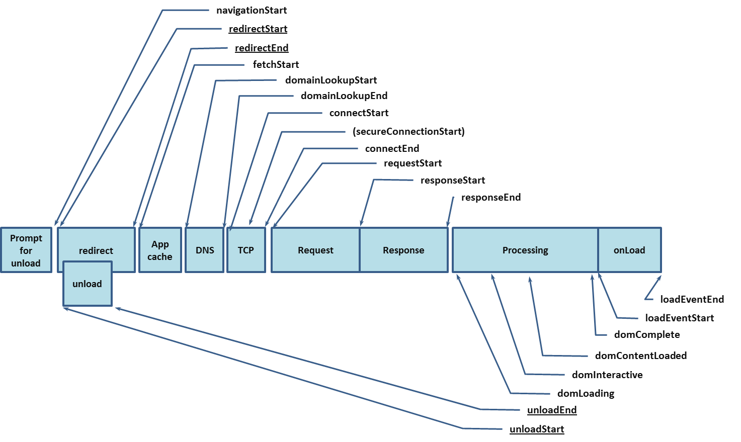
Sequence of Page Loading Events

Slide 95
Navigation Timing
<html>
<head>
<script type="text/javascript">
function onLoad() {
var now = new Date().getTime();
var page_load_time = now - performance.timing.navigationStart;
alert("User-perceived page loading time: " + page_load_time);
}
</script>
</head>
<body onload="onLoad()">
<!- Main page body goes from here. -->
</body>
</html>

Slide 96
User Timing
Web developers need the ability to assess and understand the performance characteristics of their applications.
Though java script gives time in milliseconds the precision of this time stamp varies between the user agents.

Slide 97

DOM Manipulation

Slide 98
DOM Manipulation
Access and update
Content
Structure
Style

Slide 99
DOM Manipulation
Access content
document.getElementById(id)
document.getElementsByTagName(name)
document.getElementsByClassName(name)
Changing Content
document.getElementById(id).innerHTML
document.getElementById(id).style.property
document.getElementById(id).attributename

Slide 100
DOM Manipulation
document.createElement()
document.removeChild()
document.appendChild()
document.replaceChild()

Slide 101
DOM Manipulation
Properties of HTMLElement
nextSibling
nextElementSibling
children
parentNode
nodeName or tagName
nodeValue

Slide 102
Example
<div id="div1"> <p id="p1">This is a paragraph.</p> <p id="p2">This is another paragraph.</p> </div> <script> var para = document.createElement("p"); var node = document.createTextNode("This is new."); para.appendChild(node); var element = document.getElementById("div1"); element.appendChild(para); </script>

